Slide 1
Designing to Capture Evidence of Learning
EDC&I 505 J
16 May 2012

Slide 2
Our Agenda Today
WELCOME BACK!
Debrief on last week’s synchronous session
Presentations:
Liz S. - Pamela L. - Jason B. - Sharon S. - Saki U.
Discuss last week’s readings
Palloff & Pratt, 4-8; Heo et al.; Benevenuto et al.
Discuss this week’s readings
Horton (Chs. 5-6); Yu & Wu; Chen et al.
Prepare for 5/23 “theory” session
What’s a theory, anyway?

Slide 3
Debriefing our 5/9 Synchronous Session
What did you feel about the session when we were in it (in comparison to how you’d typically feel here in class)?
What things about the session struck you as positive, negative?
Did you like or dislike having peoples’ video images on-screen?
Did you pay attention to that chat function?
What else?

Slide 4
Presentations!
Jason B.
Pamela L.
Sharon S.
Liz S.
Saki U.

Slide 5
Morning of the MOOCs
If you’ve not yet done so, try to look at the presentation by Daphne Koller on Stanford's MOOCs:
Announcement of the talk here at UW
Video of the talk (requires M'sft's Silverlight)
This is getting a lot of play – all our futures could be affected!

Slide 6
Learning Analytics and the Future of Education
Maybe large-scale data capture (and review, to improve instruction and learning) is what technology in education is really all about?
Khan Academy
Wireless Generation
Promethean

Slide 7
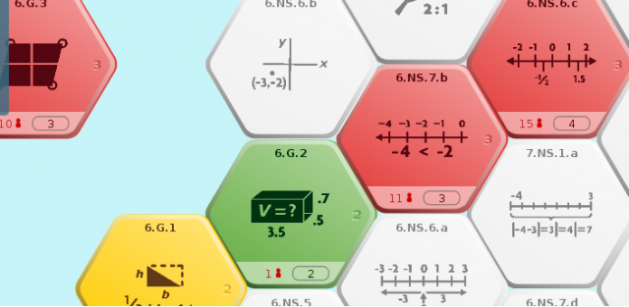
Issues Suggested by the Advent of Data Analytics
How to present data to an instructor in ways that allow easy identification of places where learners are struggling?
Probably not a grade book…
Some form of infographic?
Then people need to learn how to read, interpret, use, …

Slide 8
More Issues…
How to design all sorts of curriculum and learning materials so that students’ work is captured and preserved?
How often and at what level of detail to present data to an instructor?
What expectations to have of instructors in modifying instructional approaches or student interaction?
How to use for institutional analysis (e.g., all sections of one class, w. different instructors, etc.)?

Slide 9
And Perhaps Most Important for Instructors
How to capture, analyze, and present information about the less easily quantifiable aspects of learning and instruction?
Student responses that are text based and sometimes narrative
Results from team-based work
Results that have to do with affective learning, preferences, reflective abilities, empathy, etc., etc.

Slide 10
Questions (from 5/9)
Palloff & Pratt (4-8):
What approaches to metnoring faculty/teachers do you feel would work best in your particular setting? Why?
Are there implications for initial selection of faculty/teachers that the development models presented by P&P point to?
Heo et al.:
What sorts of supports, prompts or “scaffolding” could be provided to encourage more in-depth interaction in online project-based learning courses?
Benevenuto et al.:
What possibilities do you see for using the “video response” fetaure of YouTube for ewducational purposes? What sorts of “opportunistic behavior” might arise in educational settings?

Slide 11
Questions (5/16)
Horton (Chs. 5-6):
For a project-based online learning task in which learners interact as part of a team, devise a realistic and meaningful assessment approach that assures you can capture evidence of each learner’s contribution as well as judge the overall quality of the project
Yu & Wu:
What learning situations could you imagine where anonymity between learner and instructor might be more desirable than name revelation as an interaction mode?
Chen et al.:
What sorts of support might be needed to help learners (who have not had prior experience with high level prompts) to be able to respond effectively to them?

Slide 12
For Next Week (5/23)
Theory?!?
Identify one theoretical perspective that you believe will help you make sense out of your particular focus in online or distance learning
From what discipline does it come?
How will it help you understand existing phenomena and issues you observe?
How does it help you predict what may happen under given circumstances?
Review questions (above, as not addressed on 5/16) for discussion
Final Project Check-In
Discuss Format for final project discussions
Special snack requests!

